Slide 1
Checkers
Client-Server Checkers Implementation In Java Using Swing, OCSF Abstract Server/Client, and MySql Integration.
Aidan Robertson
Jonathan Rauch
Zachary Harp

Slide 2
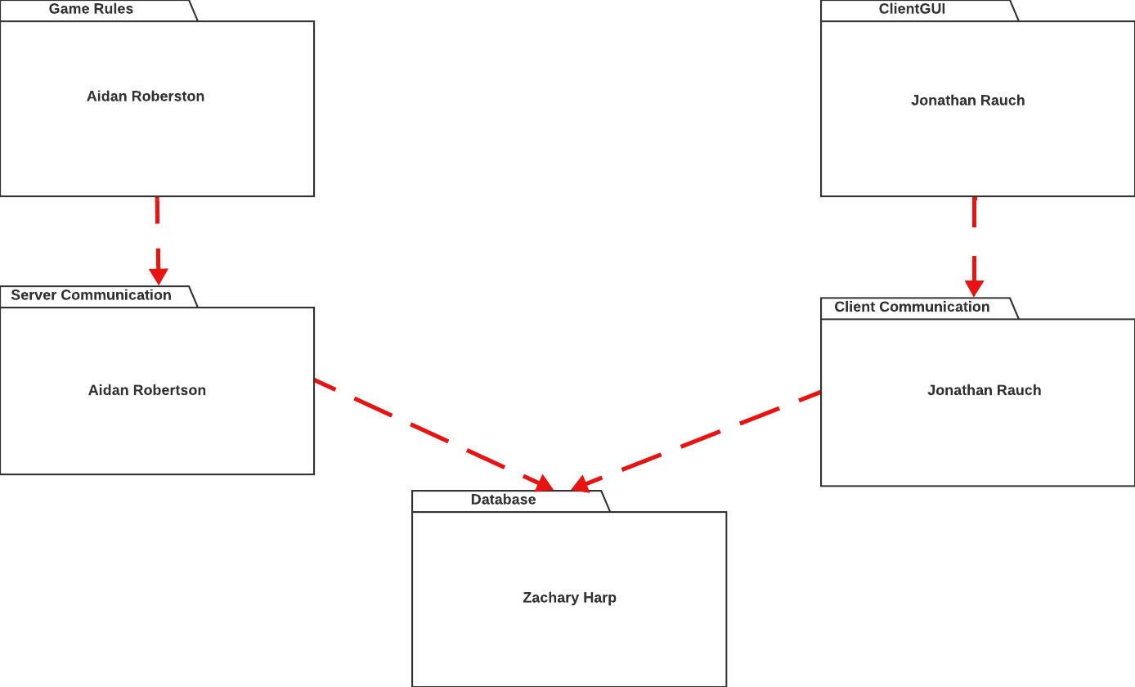
Package Diagram

Slide 3

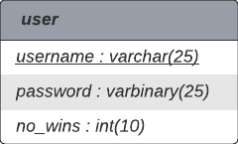
Database Design Diagram

Slide 4
Functional Requirement Example
· Player can start a new game of Checkers and wait for another person to join. (New Game)

Slide 5
Use Case Description
Use Case: New Game
Actors: Player
1. Player chooses the “New Game” option.
2. System displays a “Waiting For Another Player To Join” message.
3. System waits for another Player to join.
4. System joins the next Player logged in to the game.
5. System asks the Players to click “Start” button when they are ready to start.
6. Both Players click on the “Start” button.
Entry Condition:
Only one Player is logged in and is not currently in a game.
Exit Condition:
The username of the joined opponent shows up on the screen. After clicking “Start,” both
Players are presented with the game board and all pieces.

Slide 6
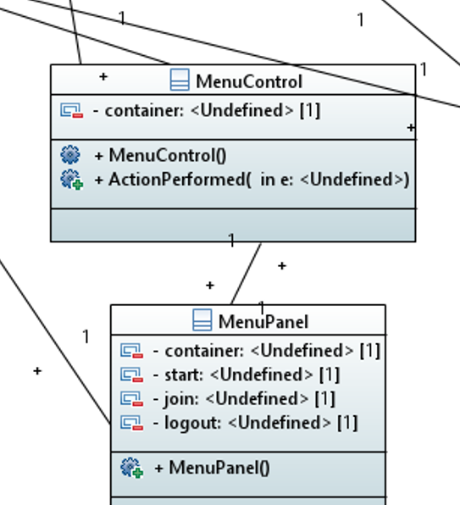
Class Diagram

Slide 7
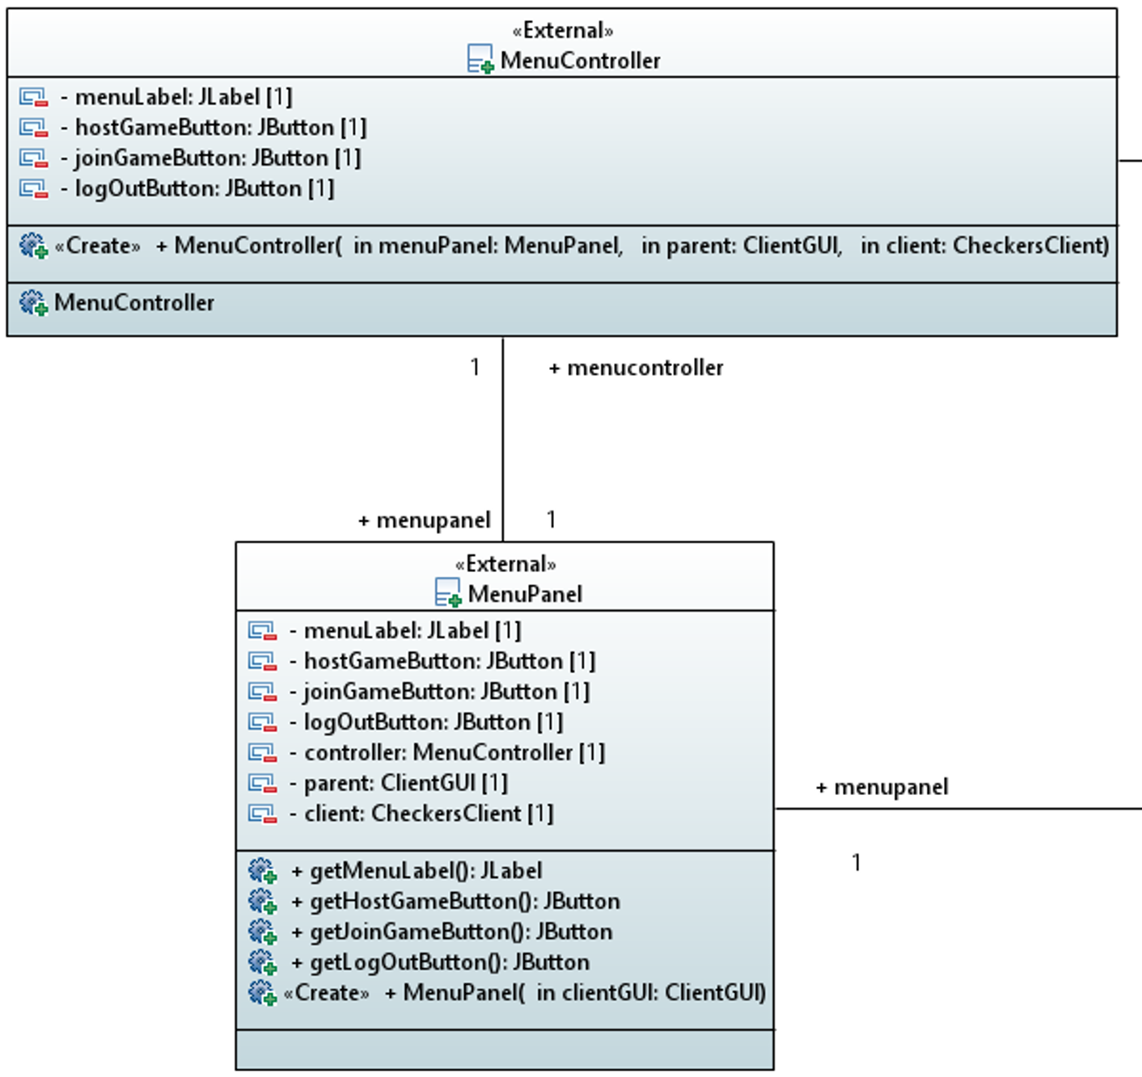
Final Class Diagram

